Slide 1
Obesity and Smoking Study-Pittsburgh
Chethan Singh M J
CMU-HEINZ COLLEGE | PITTSBURGH-PA
GIS – Assignment 2-2
Chethan Singh MJ CMU-HEINZ COLLEGE | PITTSBURGH-PA

Slide 2
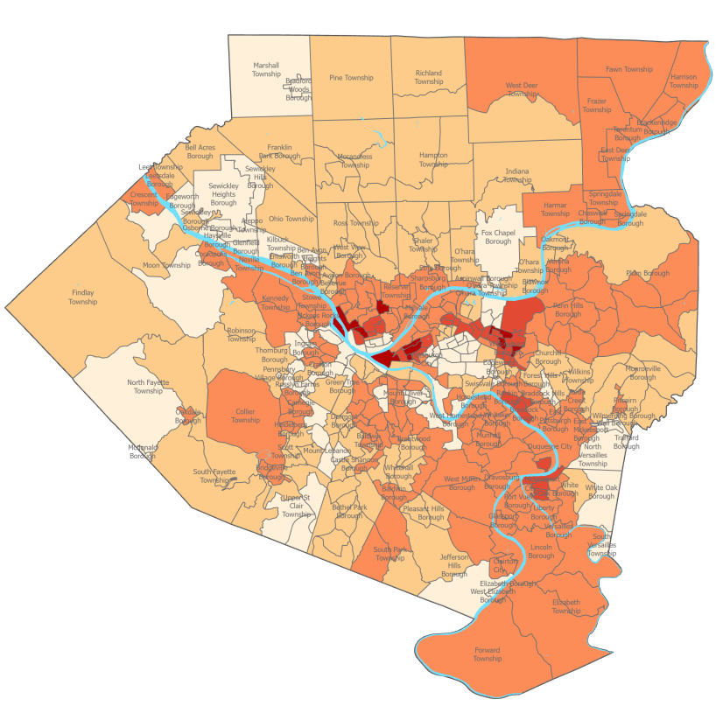
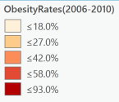
Obesity Rates
Data Sources:
Rivers : This data set contains water body name, shape, shape length, shape area and the county id
Obesity : This Data has obesity rates for each Municipality in Alleghany County, PA for period between 2006-2010
Municipalities : This data has name, shape, shape length, area and county , city details
Classification was done by creating choropleth map of obesity rate (2006-2010) using below 5 manual breaks:
0 – 18%
18.1 – 27%
27.1 – 42%
42.1 – 58%
58.1 – 93%

Slide 3
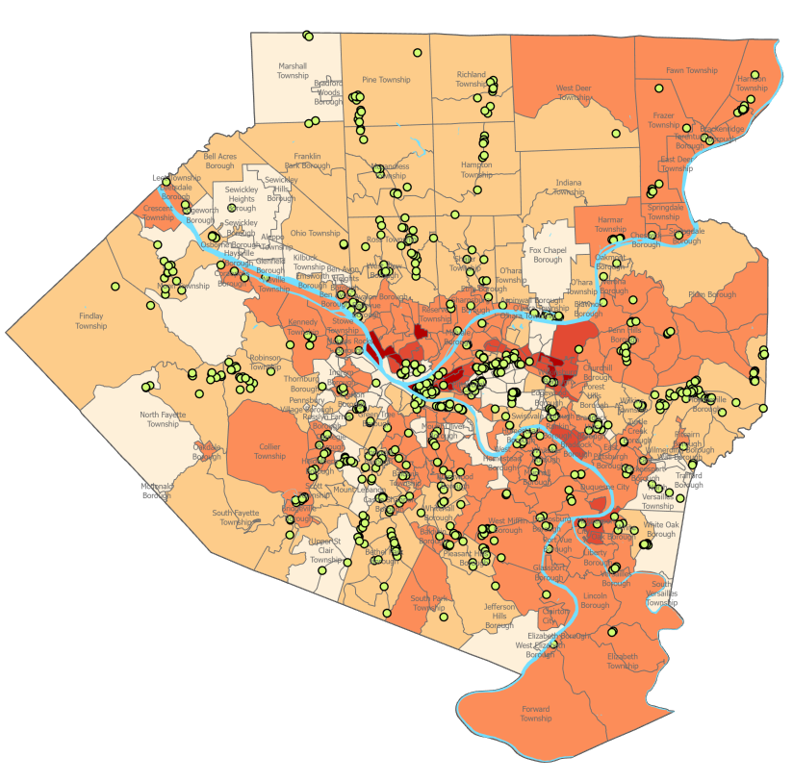
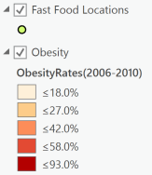
Obesity Rates and Fast Food Locations
Data Sources:
Rivers : This data set contains water body name, shape, shape length, shape area and the county id
Fast Food Locations: This data contains name, street address and GPS coordinates ( latitude – longitude) for fast food locations
Obesity : This Data has obesity rates for each Municipality in Alleghany County, PA for period between 2006-2010
Municipalities : This data has name, shape, shape length, area and county , city details

Slide 4
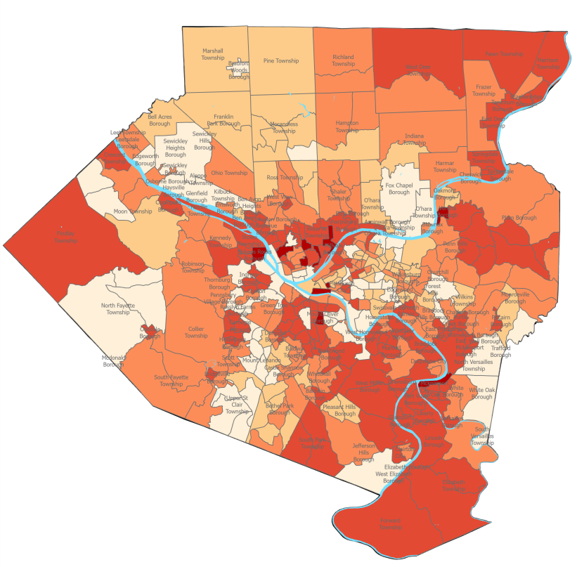
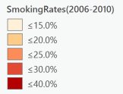
Smoking Rates
Data Sources:
Rivers : This data set contains water body name, shape, shape length, shape area and the county id
Smoking Rates : This Data has smoking rates for each Municipality in Alleghany County, PA for period between 2006-2010
Municipalities : This data has name, shape, shape length, area and county , city details
Classification was done by creating choropleth map of smoking rate (2006-2010) using below 5 manual breaks:
0 – 15%
15.1 – 20%
20.1 – 25%
25.1 – 30%
30.1 – 40%

Slide 5
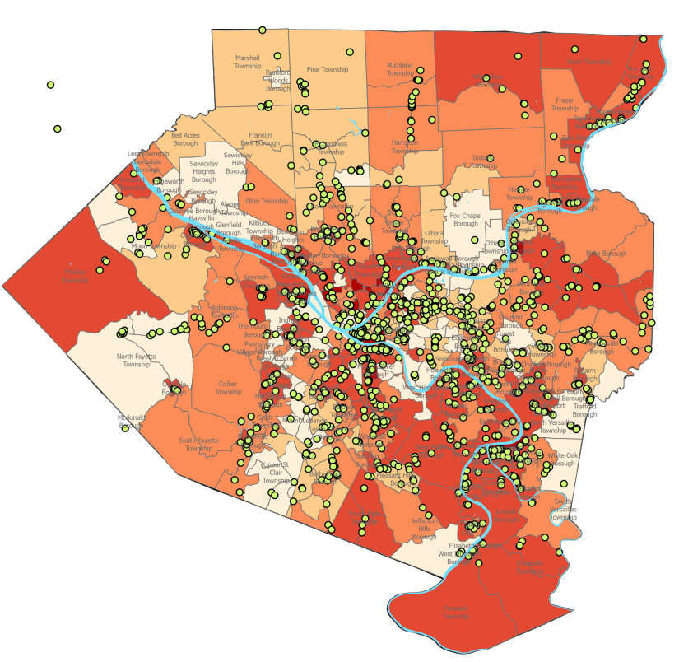
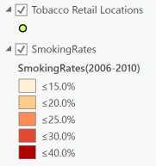
Smoking Rates and Tobacco Retail Locations
Data Sources:
Rivers : This data set contains water body name, shape, shape length, shape area and the county id
Tobacco Retail Locations: This data contains name, street address and GPS coordinates ( latitude – longitude) for tobacco retail locations
Smoking Rates : This Data has smoking rates for each Municipality in Alleghany County, PA for period between 2006-2010
Municipalities : This data has name, shape, shape length, area and county , city details

Slide 6
Summary
Pittsburgh City in Alleghany County, PA has higher rates of obesity and smoking rates.
Pittsburgh City also happen to have higher concentration of fast food restaurants and tobacco retail locations
Many of the townships with lower obesity rates also have lower smoking rates. For example: North Lafayette, Mount Lebanon, Fox Chapel Borough, etc.
Certain townships even with lower concentration of fast food restaurants and tobacco retail stores have higher obesity and smoking rates. For example: Forward Township, Elizabeth Township, etc.

